Slide 1
Homeless in the Panhandle
Faith Community Coalition
For The Homeless
Martinsburg, WV

Slide 2
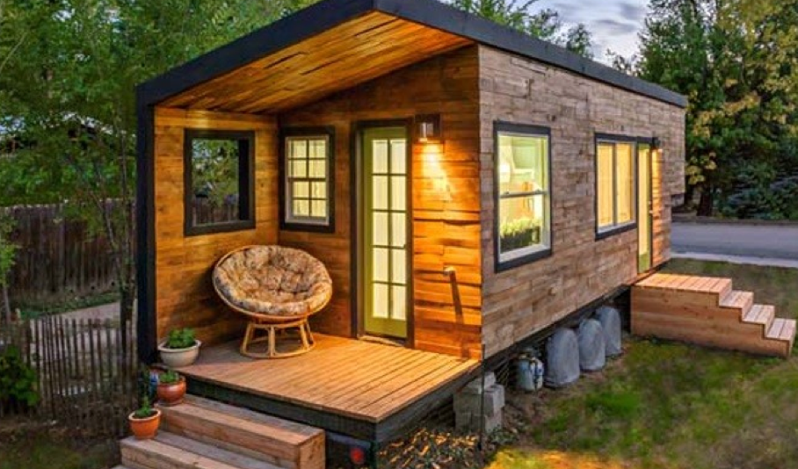
What is home???

Slide 3
Losing Your Home means
*Loss of your possessions
*Loss of your dignity
*Loss of your safety

Slide 4
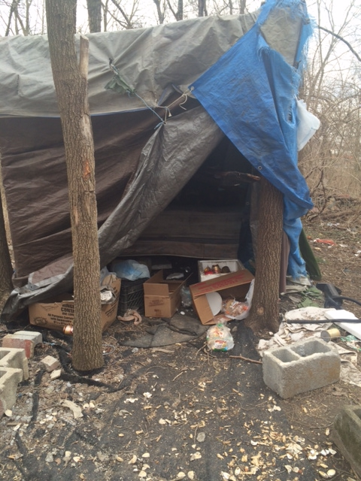
Right here in Martinsburg

Slide 5
The Numbers
*According to the Census Bureau, Martinsburg has 28% of the population living below the federal poverty line.
*The 2014 Point in Time Survey identified several hundred people living homeless, which often doesn’t count those who are couch surfing or staying in temporary housing that can and does change.

Slide 6
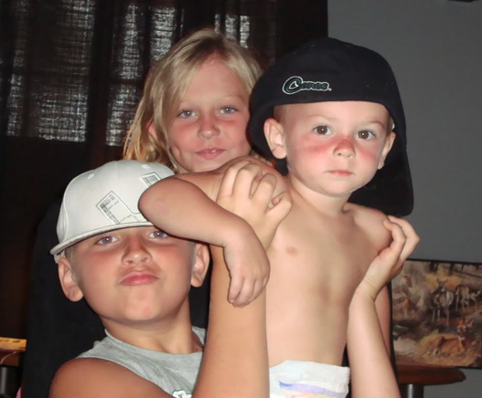
Homeless Families

Slide 7
Homeless Children
*Hungry
*Insecure
*Studies show significant impact on learning

Slide 8
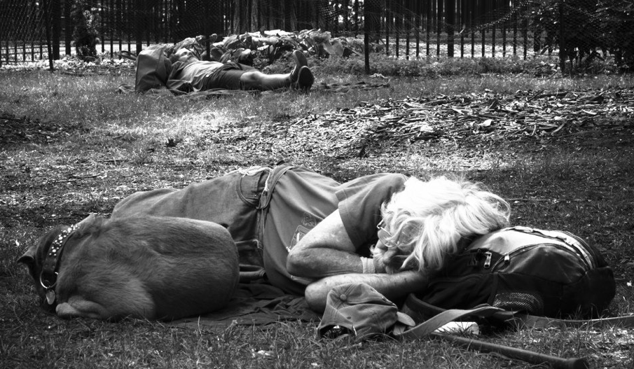
What Can We Do???

Slide 9
Faith Community Coalition for the Homeless
Founded in 2013
Mission: To educate and engage the community about homelessness, and provide opportunities to serve.
What we do: Raise funds and donations to provide emergency hotel stays, sleeping bags and camping supplies, food, and referrals/support for those who find themselves homeless.

Slide 10
Partners
Catholic Charities- fiscal agent
WV Coalition to End Homelessness
Path Program (Projects for Assistance in Transition from Homelessness)
Focusing on most vulnerable
Focusing on rapid re-housing

Slide 11
How You Can Help
Come to one FCCH meeting and take an update back to your faith community
Drag one sleeping bag out of your basement or garage and donate
Buy one extra bag of socks or underwear next time you shop and donate to clothing closet
Clean out your pantry and make one pot of food to share

Slide 12
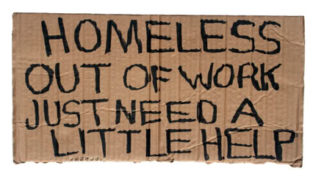
Call Us
Elizabeth Granzow 301-514-7870
Marie Keegin 240-405-6794

